Slide 1
Software Architecture
Evolution: Erosion & Smells
Damian A. Tamburri, Ph.D.

Slide 2
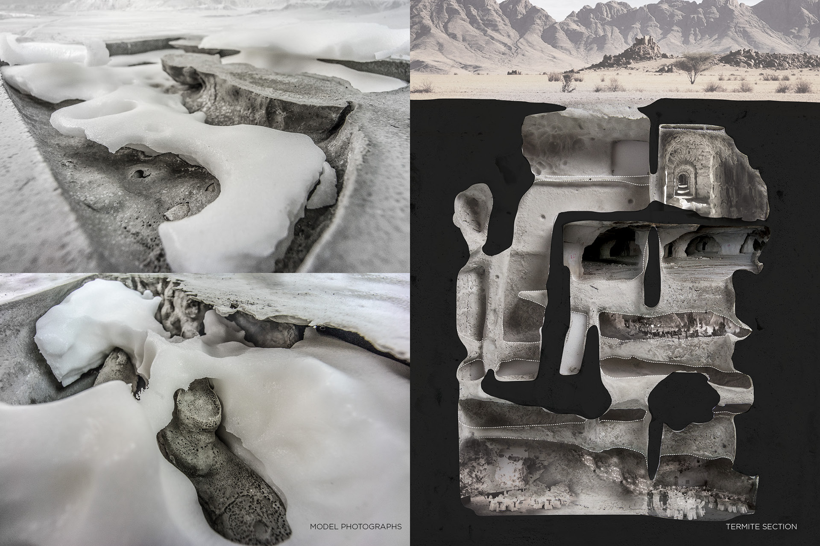

Slide 3
Architectural Erosion and Debt
Architecture Erosion ‘worsening over time’
  What are the root causes that tend to erode the architecture?
  Practice: If we know the root causes, we may try to avoid or mitigate them...
Technical Debt ‘quick-fix now, clean up later’
  What is it?
  What are the types of debt?
  Can we measure it?
  Practice: If we know root causes, we may try to avoid or mitigate them...

Slide 4


Erosion/Debt?
Two concepts – what is the difference?
CSMR2012
Wikipedia
Fowler, 2003

Slide 5
My Perspective
Erosion / Decay
  All the processes that ‘widens the gap’ between as-designed and the as-implemented software architecture
    (If you never designed one, there is not erosion, by definition ☺)
Debt
  The actual code changes that are not aligned with the as-designed architecture
  Refactoring/clean up processes can ‘lessen the gap’ / ‘re-align as-implemented with as-designed’

Slide 6
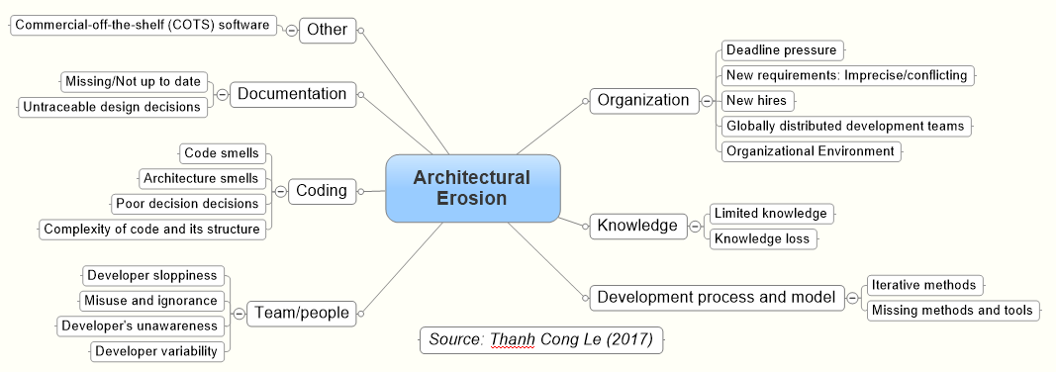
Or... Graphically
Debt

Slide 7
Agenda
Architecture Erosion [Le, 2017]
  Definitions and root causes
Technical Debt
  Definitions and Types [McConnel, Krutchen et al.]
  Measurement [Kazman et al.]
    And a seemingly result in important root causes

Slide 8
Terms and Definitions*
Le has made an impressive literature study to answer the following research questions:
NOTE: The English in the report is sometimes a bit denglish: ‘Carl means that…’
* Le’s Master Thesis contains the full work.

Slide 9
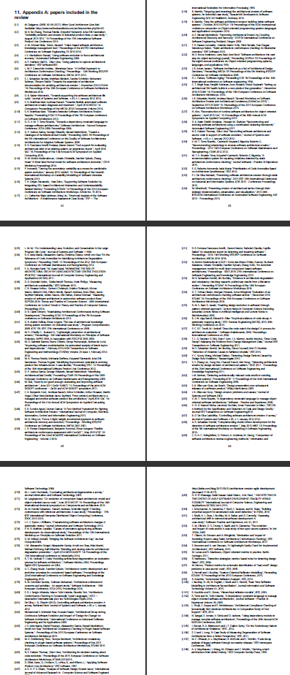
Literature Study
Systematic literature study
  Initial search
  Include references in primary papers
  New terms for ‘architecture erosion’ included
    Extra 12 papers
  Total: 108 full papers.

Slide 10
Definition
Synonyms
  Architecture erosion
  Architectural decay
  Software erosion
  Design erosion
  Design decay

Slide 11
Visualization
Note:
  It is not a documentation
  issue...
  A as-designed architecture
  may not be documented in
  written form, but still exist.
    ”Ask the architect”

Slide 12
Root Causes
[Le, 2017]
Note: Not orthogonal aspects...

Slide 13
Architectural Erosion
Organization Aspects

Slide 14
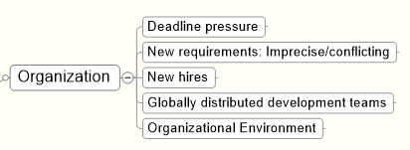
Deadline
  Focus on deadline instead of design for change
    Cunningham: ”not quite right code which we postpone making it right”
  New requirements: hard/imprecise/conflicting
    Code that do things not designed to do
  New employees
    New people, unaware of architecture details, code based upon perception/assumptions instead of knowledge

Slide 15
Deadline
  Global teams
    Again, code on assumptions more than knowledge
    ‘Us’ versus ‘them’ / problematic knowledge transfer
    Cultural misunderstandings
    Problematic communication lines, too little communication
  Organization environment
    Low morale, high turnover, blaming culture,
    cover-my-ass, don’t-care, ...

Slide 16
Architectural Erosion
Knowledge Aspects

Slide 17

Limited knowledge
  Again, refactorings/maintenance based upon limited/incorrect/assumed knowledge of architecture, of course leads to erosion
Knowledge loss
  Stroustrup: the best way to transfer knowledge from architect to developer, is that it is the same head
  Every designer/architect that leaves, takes a lot of knowledge away from the project/product
  Knowledge vaporization
    ”Failure to record decisions”

Slide 18
Architectural Erosion
Development Process Aspects

Slide 19

Iterative methods
  ”working software valued more than comprehensive documentation”
    Taken to the extreme, architecture information becomes very volatile, and easily ‘vaporize’.
Missing methods and tools
  Lack of tools to monitor architectural conformance is problematic.
    Open research question to create some that does just that…

Slide 20
Architectural Erosion
Team and Culture Aspects

Slide 21
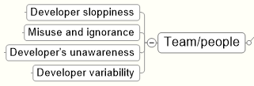
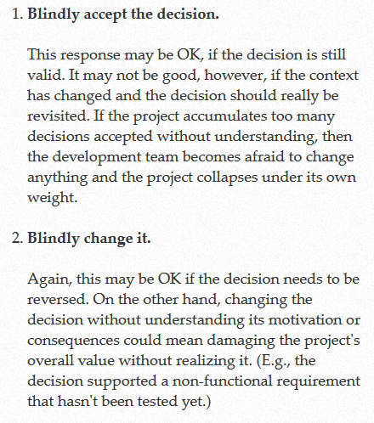
Developer sloppiness
  Laziness, not documenting/not following architecture
Misuse and ignorance
  Misunderstanding as-designed of course leads to erosion of as-implemented
    Compare Nygard ADT
  ‘Less capable’ programmers turn out less quality
  code

Slide 22
Developers’ unawareness
  Aware of basic concepts, but unaware of how to integrate in current context
    ”Knowledge and skills”
      Knowledge: Have the theory of Strategy pattern, have read the book
      Skills: Can actually find the code bit that benefit from Strategy, and correctly can introduce it
Developer variability
  Highly capable programmers turn out code that
  less capable programmers have a hard time to
  understand and modify
    Bass: ”Buildability” quality attribute...

Slide 23
Architectural Erosion
Coding Aspects

Slide 24
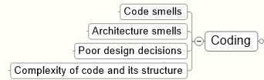
Code smells
  Blob, God class, duplicate code, spaghetti code, long parameter lists, Clean code breaking…
Architecture smells
  ISO Maintainability
    Analyzability
    Changeability
    Stability
    Testability

Slide 25
Poor design decisions
  Design decisions are hierarchical
    Bad design at upper level have many consequences at lower/dependent levels => chain reaction of revisions...
  Lack of review/debate/criticism leads to bad high level decisions
Complexity of code and structure
  (Needless) Complexity => low analyzability
int a[1817];main(z,p,q,r){for(p=80;q+p-80;p-=2*a[p])for(z=9;z--;)q=3&(r=time(0) +r*57)/7,q=q?q-1?q-2?1-p%79?-1:0:p%79-77?1:0:p<1659?79:0:p>158?-79:0,q?!a[p+q*2 ]?a[p+=a[p+=q]=q]=q:0:0;for(;q++-1817;)printf(q%79?"%c":"%c\n"," #"[!a[q-1]]);

Slide 26
Architectural Erosion
Documentation Aspects

Slide 27

Missing/Not up to date
  Inaccurate/missing documentation leads to false assumptions
  Existing documentation may not even be consulted or difficult to find
    SA@Work: Company X’s architect mentioned their architectural documentation, but, when asked, spent 15 minutes and involved two other architects in order to find it on the company file system ☺
Untraceable design decisions
  Design decisions are not manifest in code.
  Even if decision is documented, the context is not
    Alas [Tyree and Akerman, 2005]’s ‘positions’ – why were alternatives rejected?

Slide 28
Architectural Erosion
Commercial Off The Shelf Aspects

Slide 29

COTS
  COTS makes your architecture fit the COTS product, not the other way round
  COTS products that end their life but our system still relies on it

Slide 30
Not Orthogonal!

Slide 31
Detecting Erosion

Slide 32
Overview

Slide 33
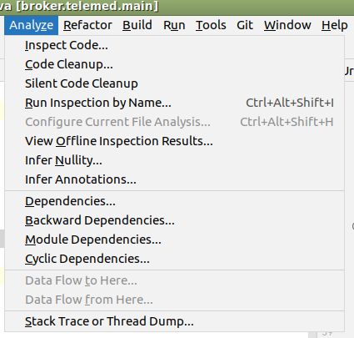
Manual Approach
Code inspection
  Focus: God class, duplicate code, long parameter lists
  Sidenote: IntelliJ has static analysis tools
Architectural artifacts inspection
  Focus: module functionality, size,
  dependencies

Slide 34
Semi-automatic
Metric based
  Detect code smells using code metrics
    Hm... I have supervised quite a few projects and so far the conclusions always seems to be: metrics tell little about quality ☹
      Ex: Low coupling is good! But what about coupling to ‘String’? Reuse X means more classes are coupled to X, right?
  SQUALE model/Sonar

Slide 35
Historical Data Analysis
Change management data history
  ‘covariance’: unrelated source files are always changed in the same commits. Maybe they are related then?
Architecture History
  (Sorry, did not get that…)
Defect-fix history
  A variant of the ‘change mgt history’ I think…

Slide 36
Compliance checking
Boils down to
  Express rules in some language
    Typically constrain dependency rules
  Make tool that match rules with code base to spot deviances
Actually, [Christensen & Hansen, 2011], proposed

Slide 37
Avoiding Architectural Erosion

Slide 38
So, What to Do?
First step: Increase architectural erosion awareness within the organization

Slide 39
Organization
Awareness

Slide 40
Knowledge
Knowledge management
  Personalization strategy
    Interaction and communication among developers
  Architectural knowledge management
    Identifying and storing knowledge in artifacts and repositories
  Make knowledge explicit
  Make conformance analyses continuously

Slide 41
[Sidebar]
[Christensen and al., APSEC 2009]

Slide 42
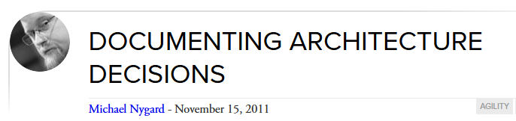
Development Process
Architecture decision enforcement
  Ensure that architectural decisions are kept enforced during implementation
    Tool support suggested by some authors
Architecture evolution management
  Manage changes in implementation and architecture in parallel
    Yes, but does sound heavy ☹
Maintenance Process…
Lightweight approach…

Slide 43
Development Process
Architecture evaluation (continuously)
  ATAM from the Bass’ book (akin of our QAW)
  [Christensen, Madsen, Lindstrøm, ECSA 2010]
    aSQA technique developed by Systematic
Compliance monitoring
  Monitoring defect metrics
    As increased defect rate and average fix time are indicators of architectural erosion
Scaled Agile Framework
  (Sorry, did not get that...)
ArchUnit?

Slide 44
Team and People
Personal Development
  Share understanding of system’s architecture
  Education
    (Ensure people follow the AU ‘SAiP’ course ☺)
Awareness
  Again, again...

Slide 45
Coding
Design Enforcement
  Architectural patterns: Know thy patterns...
  Architectural anti-patterns: Know thy anti-patterns
  Frameworks: Use them
  Review: Review code systematically
Code generation
  A really old dream: Draw architecture ➔ Code ...
Refactoring
  Clean up the mess...
Automatic test
  Supports refactoring

Slide 46
Documentation
Well-documented architecture is essential for preventing architectural erosion
  The high cost often is an inhibitor, though...
  Design rationale/decisions stressed by authors...

Slide 47
Phew...
Lots of authors and research. Lots of perspectives and views...
  Many are general observations
  Some are highly specific, and less relevant in given context
    Like ‘scaled agile framework’
But – I find there are some root causes across the line!

Slide 48
Communication!
Well-communicated architecture (decisions!) essential
  And communication means talking in a respectful environment
  Knowledge transfer so architecture survives staff churn

Slide 49
Organizational Context
Stable, friendly, good working environments

Slide 50
Knowledge and Skills
Have well trained architects and developers

Slide 51
Decisions!
Interesting to note just how many times the design rationale and decisions pops up in the papers!
Architectural views can be inferred from the code
  Module: easy, CC: hard but doable, Deploy: easy(?)
Rationale cannot!!!
  We only glimpse the decisions made, never those rejected!

Slide 52
Some E2020 Points
The participants in the E2020 added a few points to the list of architectural erosion root causes
Architecture by Management
  Dictated decisions by business people
    Which may not really be good decisions
Evolution of context at large
  External dependended-on units that reach end-of-life
  Security that is tightened
  Execution environment changes (OS updates etc.)

Slide 53
Summary
A lot of aspects conspire to erode your architecture...
  Awareness is probably the most important aspect...

Slide 54
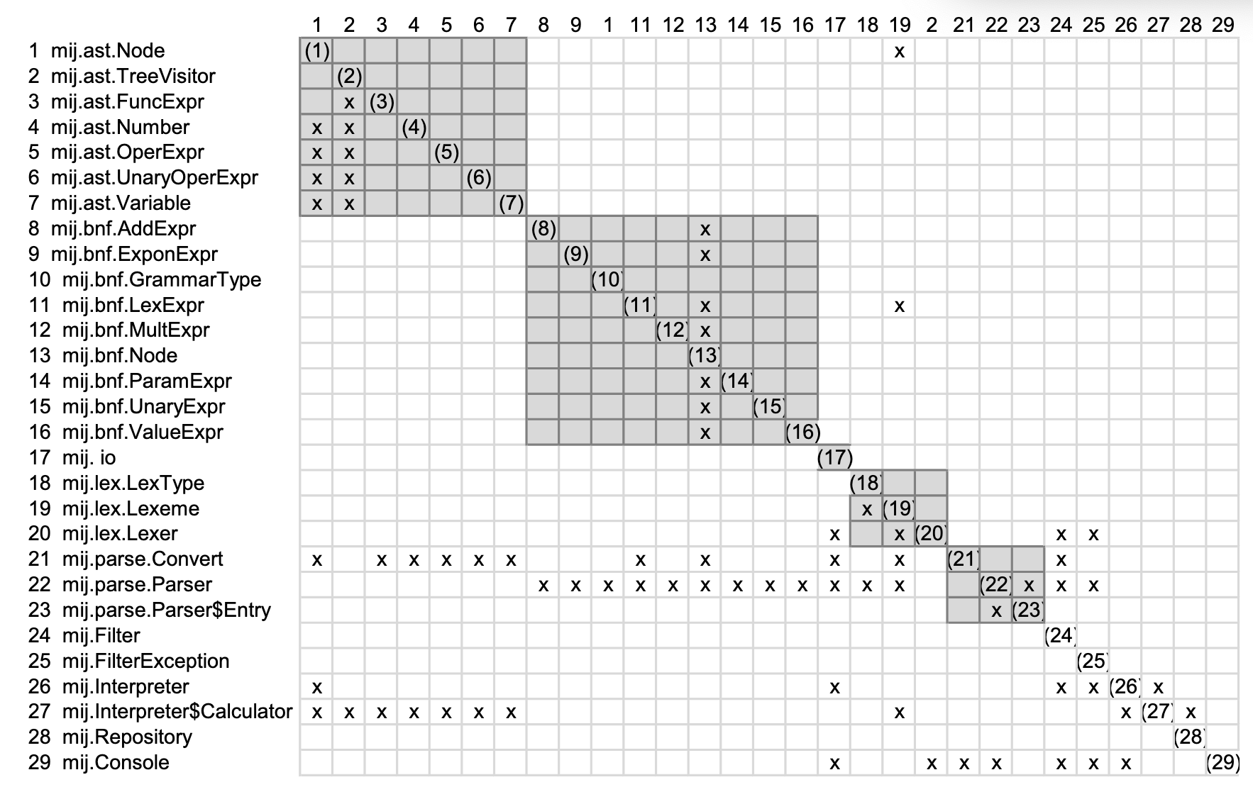
Detecting Erosion Automatically!* ➔ Arch. Smells!
*”Design Rule Spaces: A New Form of Architecture Insight” Xiao et al.

Slide 55
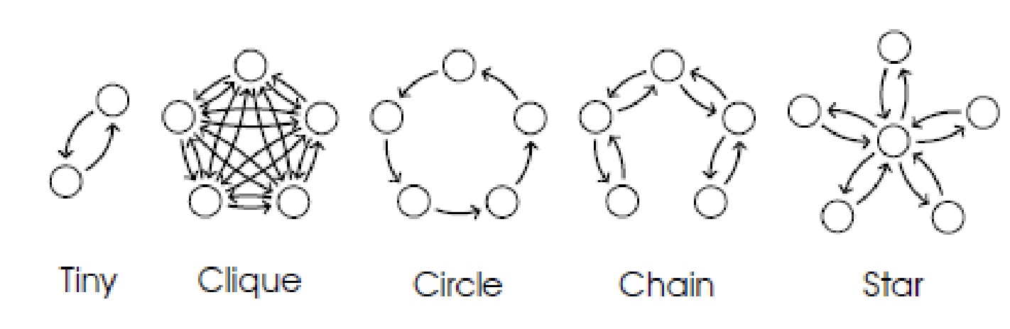
Resulting Architecture Smells: Basic Shapes

Slide 56
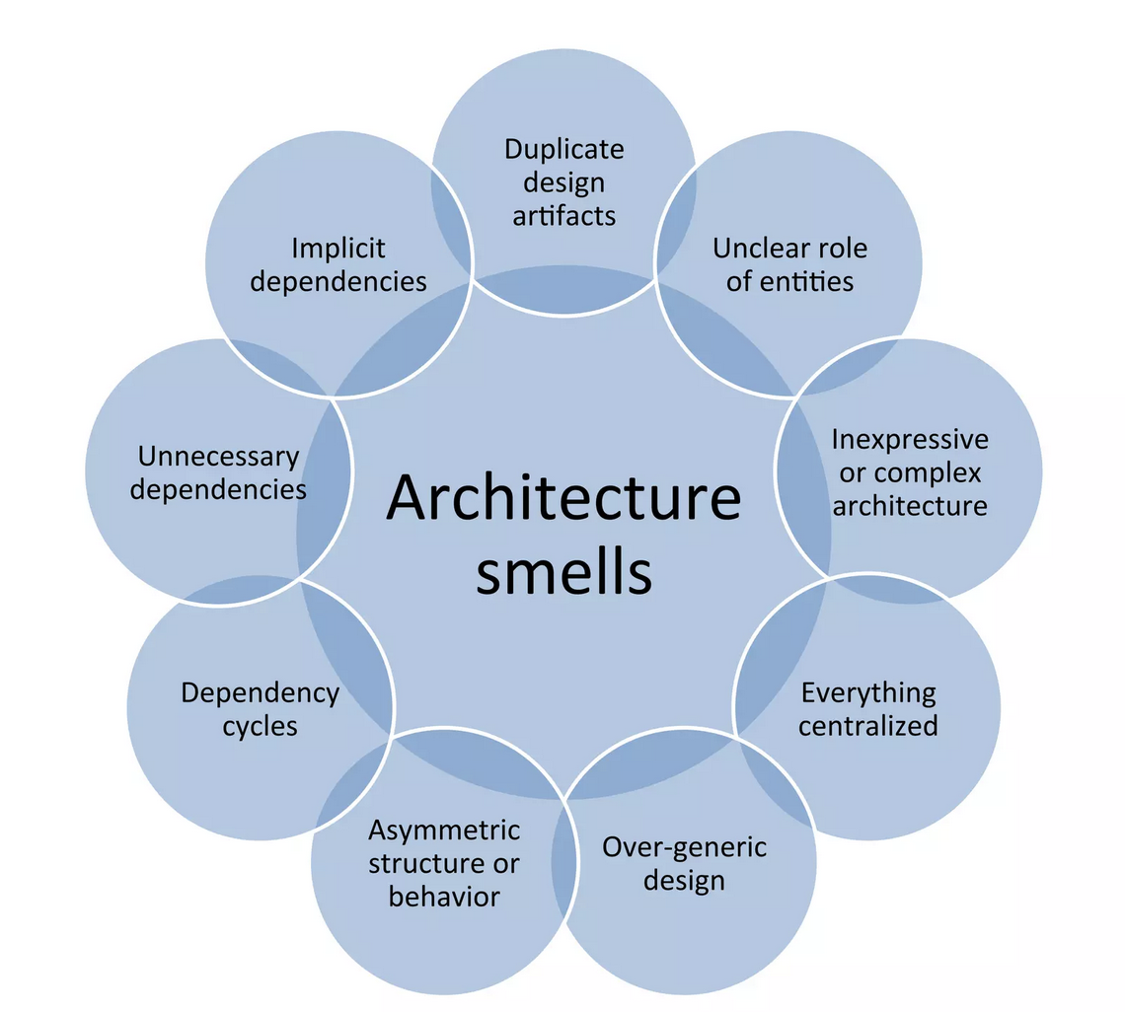
Resulting Architecture Smells:
Smells Explained

Slide 57
Resulting Architecture Smells:
Smells from MSDN*
Impossible Component Swap: this smell reflects architecture components which are too tightly connected to the rest of the architecture which may lead to substitution problems.
Untraceable Business Requirement: this smell reflects overly fine-grained architectures where it becomes difficult to trace high-level business requirements across the entire architecture. This hinders the ability to analyze the quality aspects behind that requirement and consequently the overall quality of the architecture.
Sloppy Modularisation: this smell reflects carelessly modularised architectures, e.g., architectures that decrease cohesion for no good reason. This negatively impacts the architecture's evolvability and lessens a project manager's ability to divide work cleanly among programmers.
Unscalable Architecting: this smell reflects an architecture that can barely perform its functions in the face of rapidly increasing service demands; such architectures are not built with scalability in mind and so they are typically difficult, costly, and risky to modify.
*microsoft Sw. Development Network ➔ Tamburri et al.
Notes:
https://ieeexplore.ieee.org/stamp/stamp.jsp?arnumber=9712241

Slide 58


Slide 59
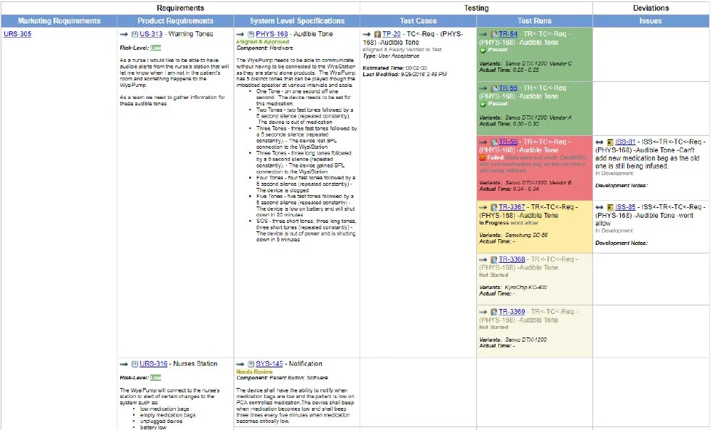

Slide 60
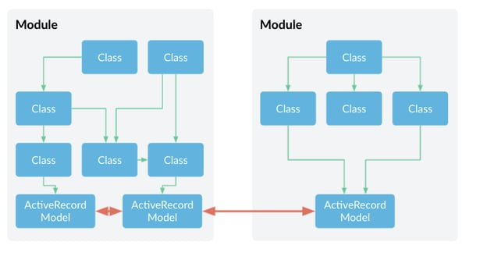

Slide 61
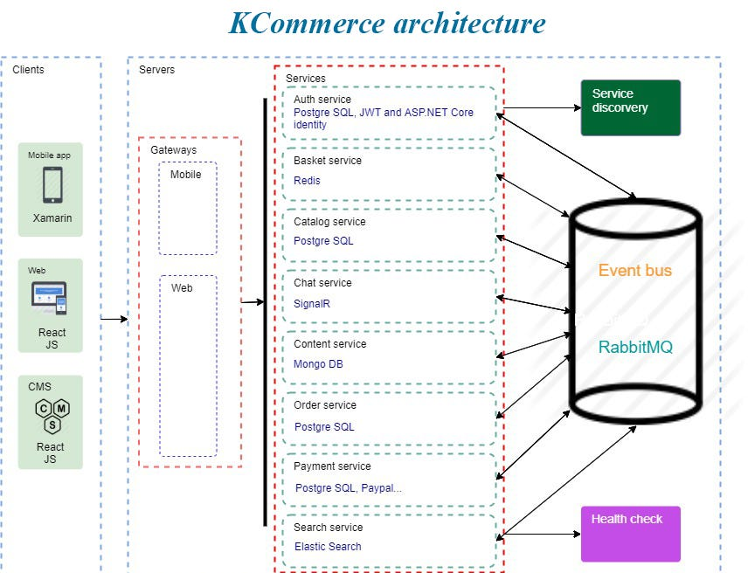

Slide 62
Resulting Architecture Smells:
Smells from MSDN*
Inflexible Architecture / God Modules: this smell reflects architectures where a small number of components or modules contain significant functionality, creating bottlenecks for maintainability.
Unmodifiable Core: this smell reflects architectures that have gradually grown out of a core which is more and more becoming functionally untouchable and incomprehensible. This is often a consequence of Sloppy Modularisation.
Spike-Centric Architecture: this smell reflects architectures that emerged from architecture spikes, i.e., ``[...] architectural spike is a test implementation of a small part of the application's overall design or architecture". Relying heavily on architecture spikes may cause severe integration and evolution issues.
*microsoft Sw. Development Network ➔ Tamburri et al.
Notes:
https://ieeexplore.ieee.org/stamp/stamp.jsp?arnumber=9712241

Slide 63
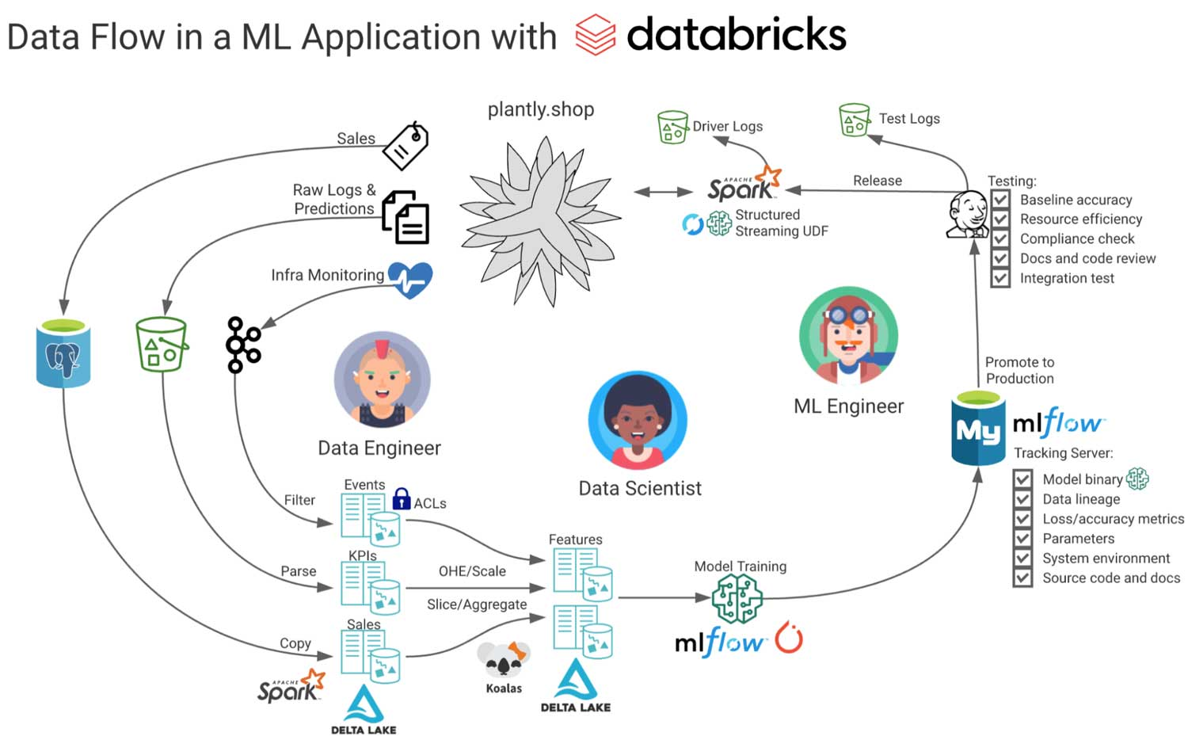

Slide 64
Resulting Architecture Smells:
Smells from MSDN*
Quality-Implicit Architecture: this smell reflects architectures for which quality analysis of one (or more) software architecture properties (e.g., performance, reliability, safety) is so complex that it is never actually done.
Architecture Monolith: this smell reflects architectures whose design has grown into a fully connected mesh and therefore cannot be evolved other than by incurring heavy refactoring costs. Such monoliths may have originated as God modules.
Insensitive Information Spreading: this smell reflects architectures in which one or more components carelessly disseminate the data that the software architecture is manipulating. This can cause security vulnerabilities as well as privacy-policy violations.
*microsoft Sw. Development Network ➔ Tamburri et al.
Notes:
https://ieeexplore.ieee.org/stamp/stamp.jsp?arnumber=9712241

Slide 65
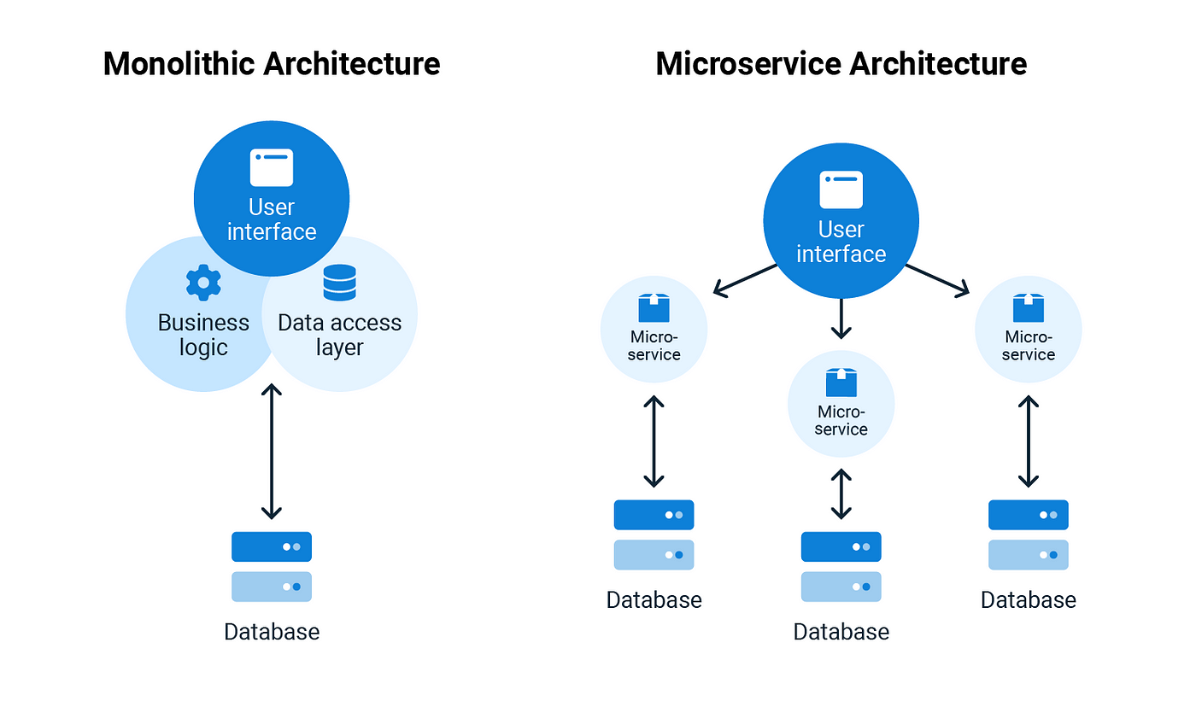

Slide 66
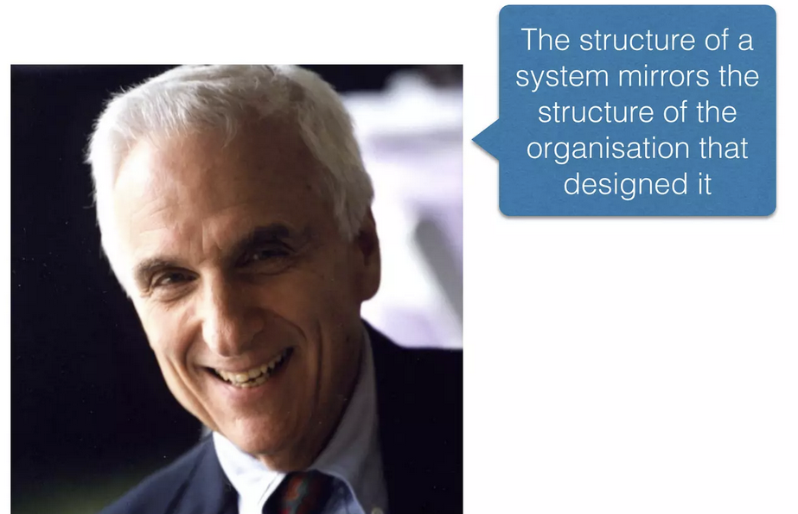
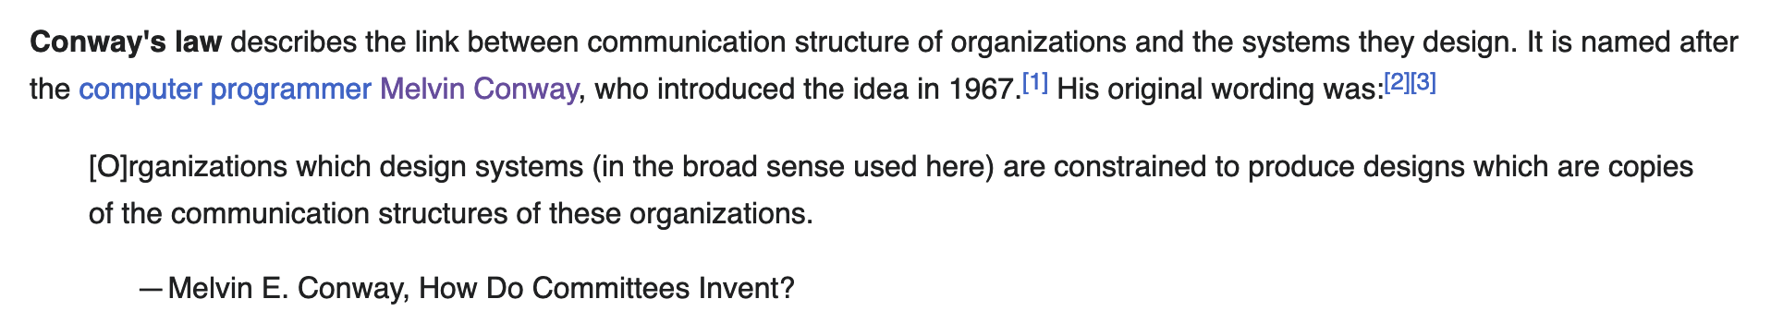
Conway’s Law

Slide 67
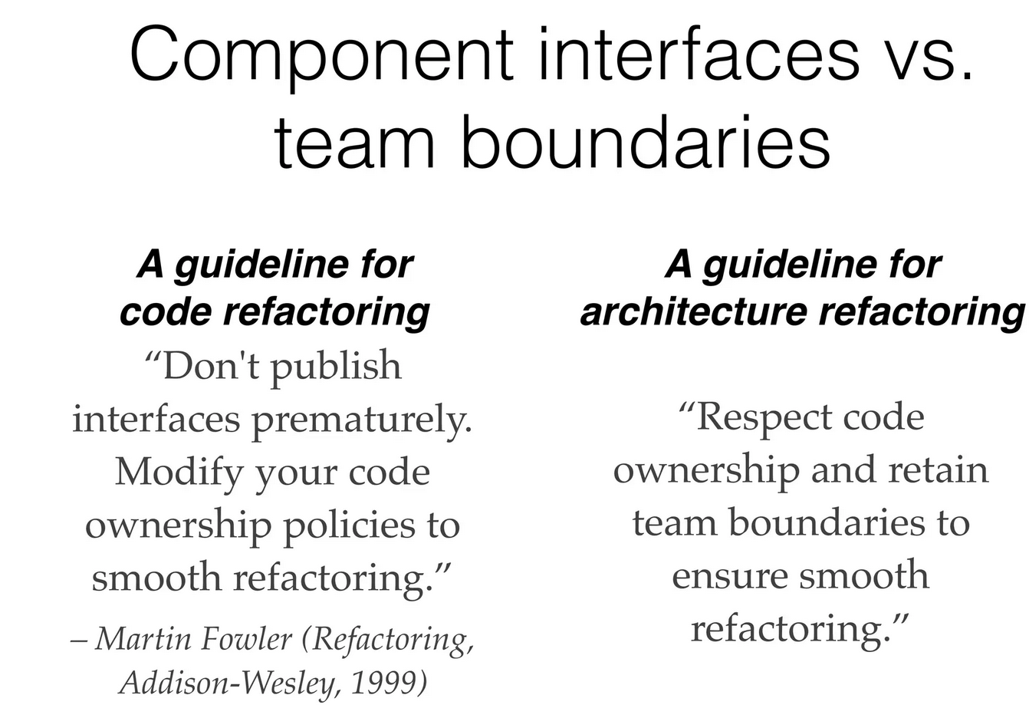

Slide 68
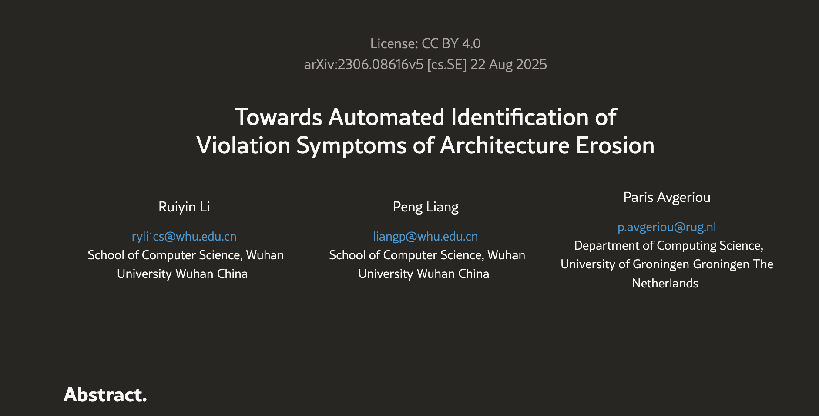
The LLM bit…
“We identify violation symptoms of architecture erosion from developer discussions in code reviews.”
“LLMs outperform the baseline by 0.05 F1-score”

Slide 69

Questions?

